Slide 1


Team Members: Awais Asghar Muhammad Ashar Javid Muhammad Hammad Sarwar Huzaifa Ahmed

Slide 2
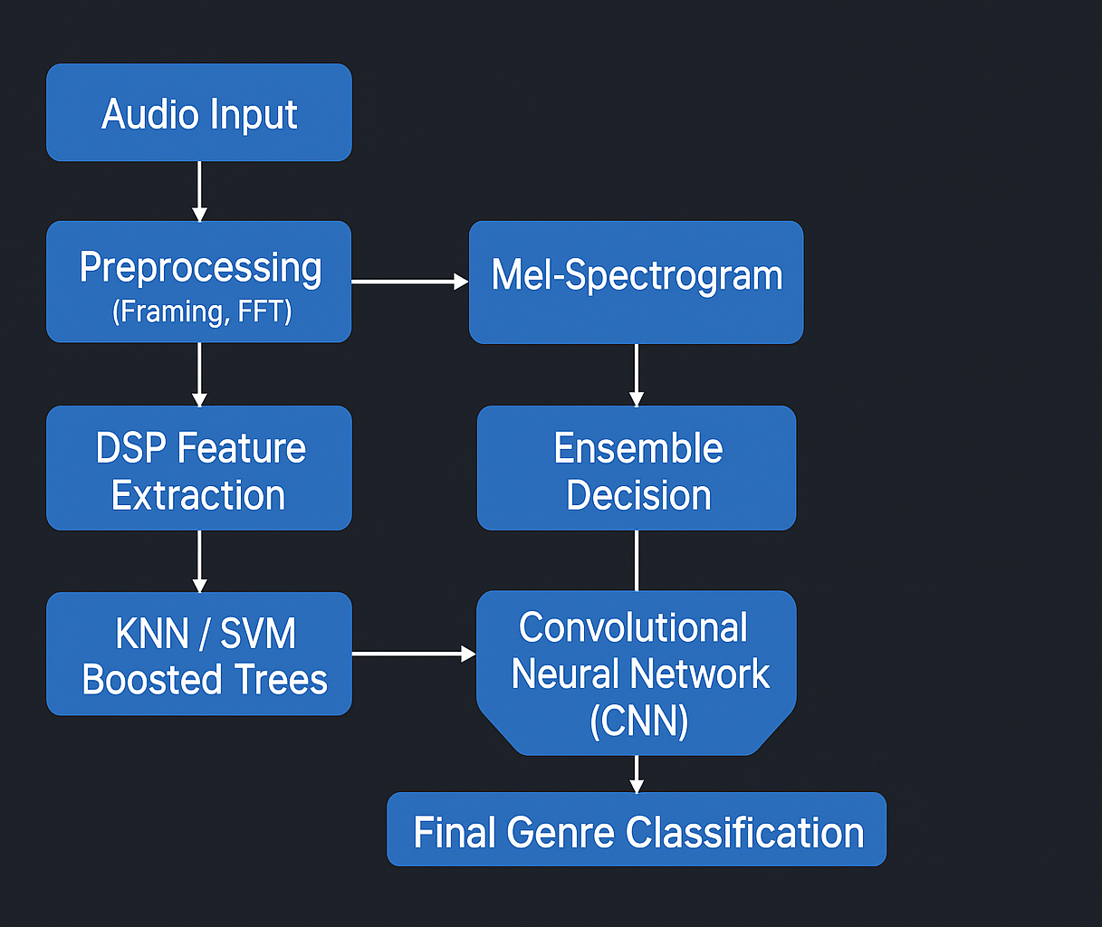
Flowchart

Slide 3
Results
Boosted trees Accuracy: 68% (Performs exceptionally well on International)
KNN Accuracy: 71% (Performs exceptionally well overall)
SVM Accuracy: 65.5% (Performs exceptionally well on Hiphop)
CNN Accuracy: 49.75% (Performs exceptionally well on Folk)

Slide 4
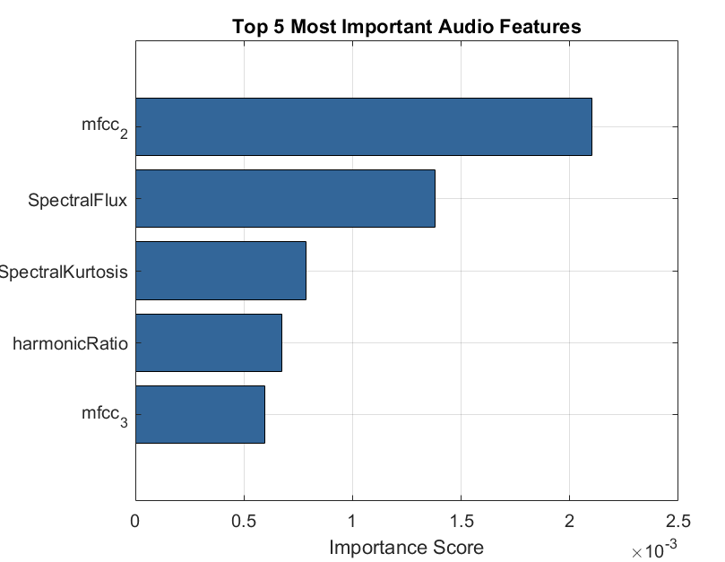
Top Features

Slide 5
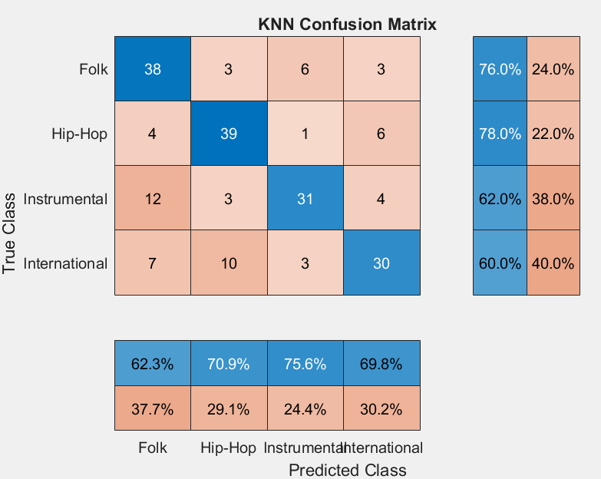
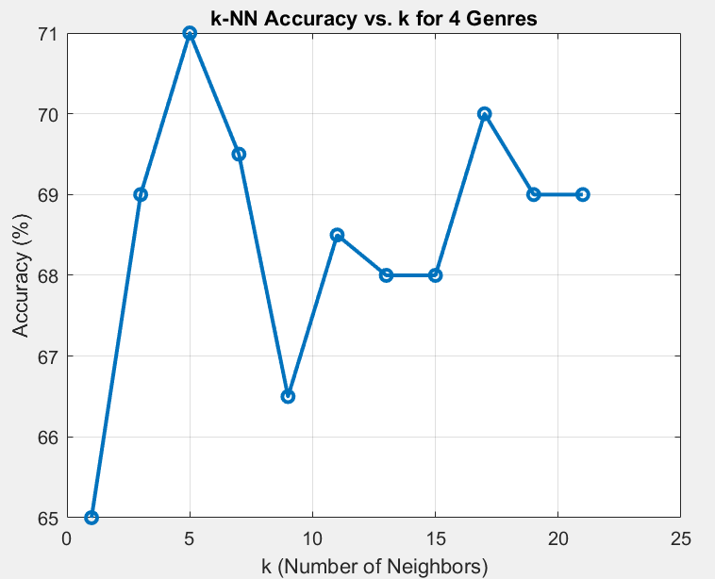
KNN Results:

Slide 6
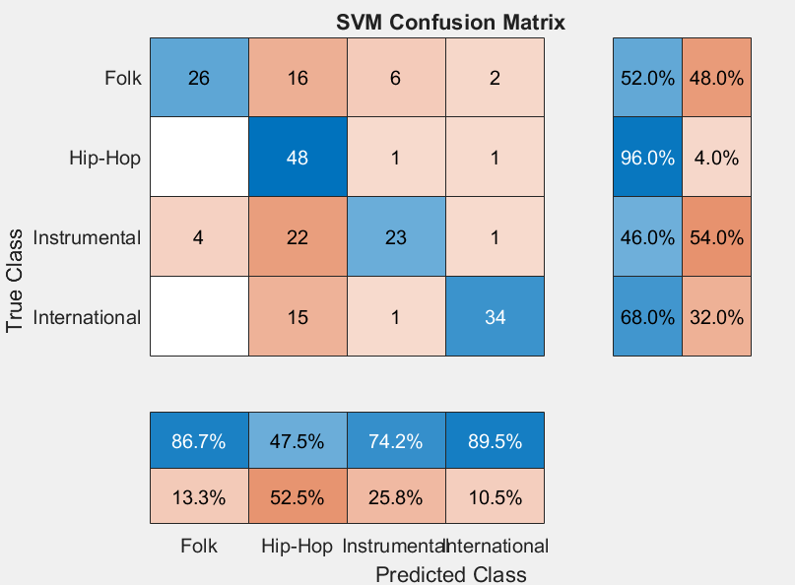
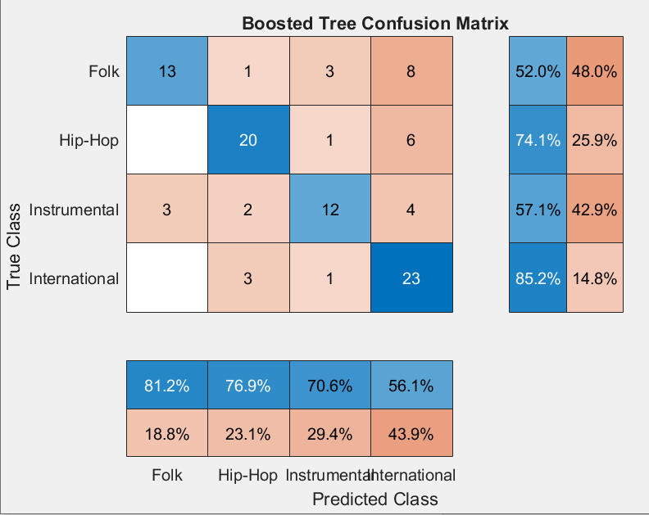
SVM & Boosted Trees Results

Slide 7
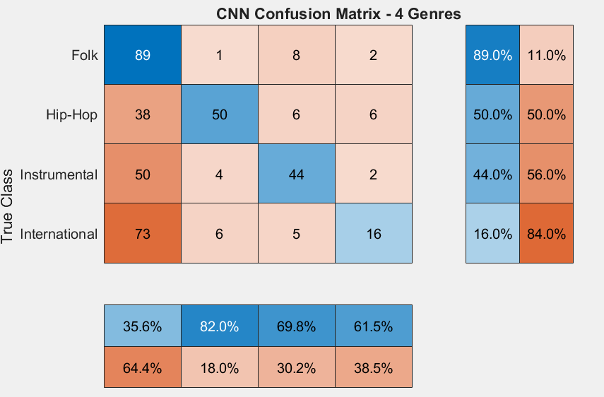
CNN

Slide 8
Folder Structure
DSP-Based-Music-Genre-Classifier/
├── Source code/
│ ├── Boosted_Trees.m
│ ├── SVM.m
│ ├── KNN.m
│ ├── Features.m
│ ├── Clean_Data.m
│ ├── GUI.m
│ └── cnn.m
├── Data/
│ ├── fma_advanced_features_max5000.mat
│ ├── fma_cleaned_features.mat
│ └── genre_cnn_model_4genre.mat

Slide 9

Thank You

